Slide 1

Technical Presentation
Development, Implementation & AMC (05 years) of National RCO Portal, Bureau of Energy Efficiency
Bid Number: GEM/2024/B/5588857
January 2025

Slide 2

Table of Contents
About Deloitte
Our Understanding of scope
Approach and Methodology
Proposed Solution
Work Plan

Slide 3


About Us

Slide 4

About Deloitte
Deloitte is one of the world’s largest and most diversified professional services organizations
Committed to being the best, raising the bar higher and setting the pace for others to follow
Delivers against a broad and deep multidisciplinary portfolio of business capabilities that is distinctive in our profession
Recognised as a leader by independent experts across most capabilities and industries of any professional services provider
Redefining how our professionals serve clients and the public interest by making an impact that matters
Deloitte member firms serve 75% of the 2024 Fortune 500 companies
Deloitte
FY2025
Countries and territories
Societal investments
150+
US$416M+
Revenue
Headcount
US$70.5B
470,000
Offices
New hires
760+
92,910

Slide 5
About Deloitte
Deloitte is one of the world’s largest and most diversified professional services organizations
Committed to being the best, raising the bar higher and setting the pace for others to follow
Delivers against a broad and deep multidisciplinary portfolio of business capabilities that is distinctive in our profession
Committed to being the best, raising the bar higher and setting the pace for others to follow
Delivers against a broad and deep multidisciplinary portfolio of business capabilities that is distinctive in our profession
Deloitte member firms serve 75% of the 2024 Fortune 500 companies
Deloitte
FY2025
Countries and territories
Societal investments
150+
US$416M+
Revenue
Headcount
US$70.5B
470,000
Offices
New hires
760+
92,910

Slide 6
About Deloitte
Deloitte India is one of the leading professional services firms with a rich heritage of serving the best-in-class clients in India
Strategy, Risk & Transactions
Services in India
Assurance
Technology & Transformation
Tax
Our Industry Focus
Professionals spread across
Power Sector Experts
IT Experts
Consumer
36000+
400+
10000+
New Delhi
Noida
Energy, resources & Industrials
Deloitte serves 61% of FG500 2023 ENERGY, resources and industrials companies
Deloitte is a Leader in 2025 Gartner® Magic Quadrant™ for Custom Software Development Services!
Deloitte scored highest among all providers in the Unique Products Use Case for the 2025 Gartner® Critical Capabilities for Custom Software Development Services
Deloitte is a Leader in the 2025 Gartner® Magic Quadrant™ for Public Cloud IT Transformation Services!
Deloitte scores in top 3 across all Use Cases in the 2025 Gartner Critical Capabilities for Public Cloud IT Transformation report!
Ahmedabad
Jamshedpur
Financial services
Kolkata
Mumbai
Bhubaneshwar
Life sciences & healthcare
Hyderabad
Offices in Cities
Pune
Goa
14
Tech, media & telecom
Bengaluru
Coimbatore
Chennai
Government & Public services
Kochi

Slide 7
Our proven credentials | An exceptional partner to support you
Deloitte brings “best-in-class” capabilities across all aspects of strategy and innovation coupled with the experience of partnering with some of the leading clients across the world
Deloitte
Largest professional services firm globally across 150+ countries with >$16Bn consulting revenue
Generation advisory including flexible operations of thermal power plants
Renewable Energy Solutions
Dedicated strategy practice, founded by Professor Michael Porter
Energy Efficiency & Energy Audit & Power Portfolio Management
Project Management Consultancy & Capacity Building
Globally integrated energy and resources practice with more than 5000 practitioners
Services in Power & Utilities
Regulatory & Policy
Power Transmission and Distribution infra based services
Worked on multiple similar strategic assignments for leading energy clients, like BHEL, NTPC, OTPC, CIL, PGCIL, RE IPPs, etc...
E-mobility & Battery Energy Storage System
Deloitte follows “Digital Foundry” approach an aggregation of services that blends strategic expertise, governance, agile delivery methods, and innovative thinking with enabling technologies.
The team has worked extensively across all sub-sectors including generation, transmission and distribution sector.
Green Hydrogen and Climate Change
We provide audit & advisory services to most of the top Energy & resources companies in India
Steered by more than 300 practitioners in India with deep P&U consulting experience
Our integrated experienced professionals focus addressing challenges linked to global energy industry.

Slide 8
Our value proposition
We bring together deep sector knowledge with cutting edge technology implementation experience, which is critical for this assignment
Renew needs a partner who…
Deloitte’s Commitment
Has extensive experience in Indian Power Sector with deep understanding of market structure, regulations and policy
Power Sector Advisory projects in last 5 years
Worked with Power Sector clients in India over last 5 years
400+
Dedicated Power Sector Professionals
200+
100+
Has implemented not only portals but complex IT projects with multi level integration and cyber security concerns
500+
Portals & sites developments for Govt and Private
clients
Cloud Practitioners
Policy/Regulatory level work with Central Govt agencies
Has expertise in emerging technologies like Gen AI, Agentic AI and Blockchain which may be used to enhance portal in future
150+
20+
25+
Database Administrator
50+
Has multi functional team to support a complex integration IT project – Cyber, cloud, UI/UX, DBM, Architect, Data Analyst etc...
Solution Architect
Certifications needed for such complex IT work incl CMMi 5
INR 500 Cr. + complex IT projects incl Implement and Operate
5000+
Software Engineers
Has good track record of implementing and operating large complex IT projects with Govt
5+
10+

Slide 9
Our Presence in Indian Power Sector
Presence across various states and clients in India
Experience of working across states
Key Clients
CPSEs
Power Utilities
Regulator/ Energy Dept.
GTD Utilities
MoP/ MNRE
PFC
REC
POWERGRID
NTPC
NHPC
SECI
EESL
BEE
DVC
State Utilities
Private Players
Others (funding agencies)
Haryana
Rajasthan
Jharkhand
Himachal Pradesh
Uttarakhand
Andhra Pradesh
West Bengal
Madhya Pradesh
Maharashtra
Assam
Bihar
Tripura
Karnataka
Puducherry
Tamil Nadu
Tata Power
Adani
BSES
Torrent
CESC
Sterlite
Enel
NPCL
+ Several RE IPPs
Note: for representation purpose, have color coded the states based on the key stakeholder/ client, even though have projects working with multiple stakeholders in many states
Regulators
Funding Agencies
Others
Lakshadweep
CERC
OERC
HPERC
CSERC
AERC
TNERC
MERC
KERC
JERC
BERC
APERC
The World Bank
IFC
KfW
USAID
ADB
DFID
GIZ
FOR
WEC
IEX
AAI
Consumer Groups
Andaman

Slide 10















Key Relevant Credentials
Unique mix of technology and sectoral expertise distinguishes us vis a vis a pure technology player
Power Sector Credentials
PMU for RDSS, Ministry of Power
PMU Support to MNRE for PM-Surya Ghar Yojana
PMU support for RDSS, WBSEDCL
ITPMU for JBVNL
Support in Framing regulations to FoR, CERC and other regulatory bodies
Regulatory studies and papers for sustainable energy future
Resource adequacy study for CEA
Regulatory assistance to TSUISL, TSL & JUUNL
IT Sector Credentials
SAP ERP Implementation
BPCL Customer Portal as part of Digital Transformation
Digital Sansad - Reorganized and reimagined 200 years of data from 13 different portals
Development of Mobile APP and web-portal to capture on-field assets (FAR)
Developed Revamped Tata Power Website
HIM Urja Portal, Roof Top Solar Application (Single Window Clearance System)
Load Forecasting Tool, KSEB
Citizen service portal “Suvidha” ,JBVNL

Slide 11
Local presence
Deloitte India is one of the leading professional services firms with a rich heritage of serving the best-in-class clients in India
Strategy, Risk & Transactions
Services in India
Assurance
Technology & Transformation
Tax
India clientele (November 2023 BT500*)
Serves
Companies
New Delhi
Consumer
115
of
147
Noida
153
of
185
Energy, resources & Industrials
Ahmedabad
Jamshedpur
Financial services
89
of
121
Kolkata
Mumbai
Bhubaneshwar
Professionals spread across
Life sciences & healthcare
Hyderabad
46
of
78
Pune
36000+
Goa
Tech, media & telecom
53
of
85
Bengaluru
Cities
Coimbatore
Chennai
12
of
44
Government & Public services
14
Kochi
*BT500 - Business Today publication about India’s top 500 performing companies

Slide 12













Domain knowledge in Power Utilities
Unique mix of technology and sectoral expertise distinguishes us vis a vis a pure technology player
Policy formulation
Implement, Advise and Operate
Implement
Advise
We bring mix of technology and deep sectoral experience
Operate

Slide 13









Select large IT implementations engagements
We have delivered 100+ large IT implementation engagements in India region. We have delivered multiple SAP transformation engagements in energy sector
Generation
Greenfield S/4 HANA implementation with all core modules and Non-SAP solutions like HMS, SLDC, ITSM
Implementation of SAP S/4 HANA along with 3 years AMS; Modules included FICO, MM, PP, S&D and HCM
Implementation of SAP ECC solution to support enhanced customer service capabilities.
Project monitoring for National Feeder Monitoring System
Greenfield S/4 HANA implementation with all core modules
National Feeder Monitoring System
1200 FUEs
136 FUEs
1500 FUEs
Large Energy Company in US
Transmission & Distribution
Implementation of flexible, scalable and high-performance SAP CR&B platform based on HANA
SAPECC to S/4HANA RISE covering multiple decentralized systems system harmonization of all core modules and. Greenfield solution for SAP TRM and Cash Mgmt
ECC to S4 HANA Conversion and business process improvements; Modules included FICO, MM, SD, PS, PM, HCM SAP BW to BW/4 Conversion and Migration from BO to SAC
Formation of corporate strategy and Portal Development for BHEL
MIS Dashboard development for JBVNL
Himurja Roof Top Solar Application (Single Window Clearance System)
APCPDCL
Water & Gas
Shell
Avantika Gas
Improving utility customer experience by identifying and implementing improvements in Meter-to-Cash process on SAP system, SAP Support Pack Upgrade
Technical upgrade of SAP billing and collections solution to drive business efficiencies and achieve higher customer satisfaction and AMS
Technology Service Provider for Digital Transformation to BPCL
Greenfields Implementation of S/4 HANA and IS utilities; Modules included FICO, MM, PS, PM, S&D and CS
ECC to S4 HANA Conversion and business process improvements
SAP S4 HANA implementation
Greenfield S/4 HANA implementation for MM, FI and PS modules; SAP Solman Installation, SAP Fiori Activation, Integration with 3rd party OT Tools

Slide 14

Our understanding of scope

Slide 15
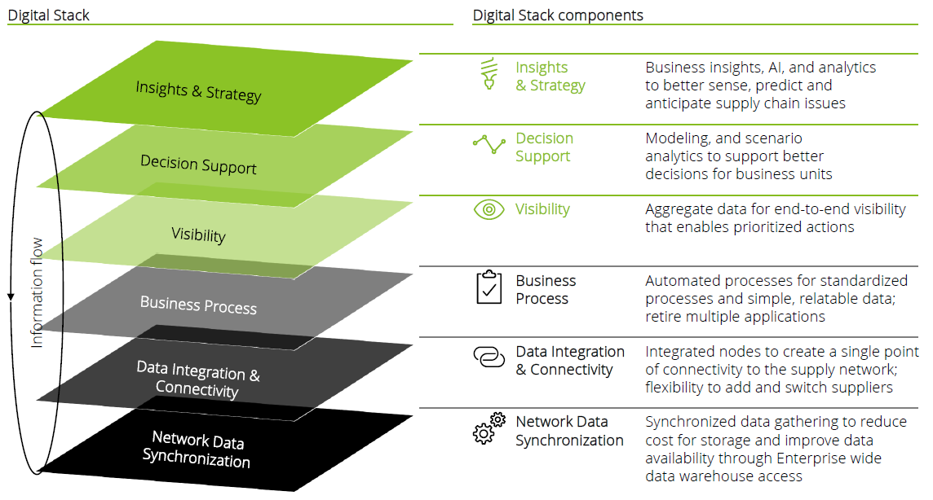
Our Understanding of Scope
Key Features & Functionalities
User Registration
 |  | unified platform for real-time tracking integration State/Regional
 |  | Data submission through web and mobile interfaces Implement robust verification workflows (SDAs, AEAs, ACVs) Resolve discrepancies using a systematic reconciliation
 |  | Automate processing, and reporting
 |  | Design a scalable system capable of handling growing user and data demands
Data
Basic Deliverable
User-Cerfaces
Scope Understanding
Automation ce
Regulatory
Advance Deliverable
Scalable

Slide 16
Approach and Methodology

Slide 17
Hybrid Delivery Model
It allows for flexible, iterative development and continuous customer feedback, ensuring that the final product meets evolving requirements and expectations efficiently

Slide 18



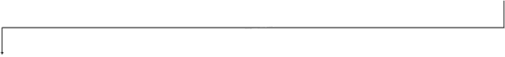

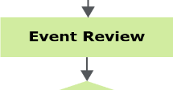


Maintenance & Support Phase
Continuous monitoring and immediate resolution of issues minimize downtime and maintain high availability, which is essential for RCO Portal Operation
Clients
L1 Helpdesk*
Key Features
Service requests or incidents
Communication and updates
Significance
?
Exception
Ensures user requests (issues, enhancements, or questions) are managed to completion
Incidents
Type?
Service requests
Incident management
New problems
Request For Change (RFC)
Incident
Management
Facilitates adherence to service-level agreements (SLAs)
Problem management
Problem, known
Change management
RFC
error information
Focuses on end-to-end service management
Incidents
Problem, known
error info
Changes
Release management
CI Update
Problem, known errors
Problem, known
error info
Supports quality initiatives
Configuration Items (CI), Relationships info
SLA management
Releases
CI’s relationships
Refines through delivery experience
Facilitates cost-effective service delivery
Day-to-day Production Support
Corrective/Preventive Maintenance

Slide 19
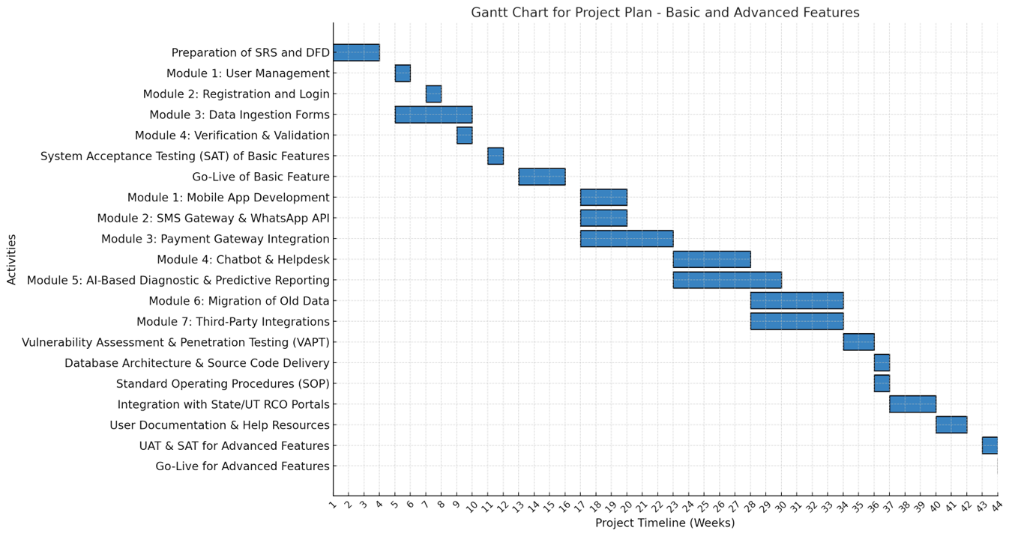
Maintenance & Support Phase

Slide 20
Proposed Solution

Slide 21
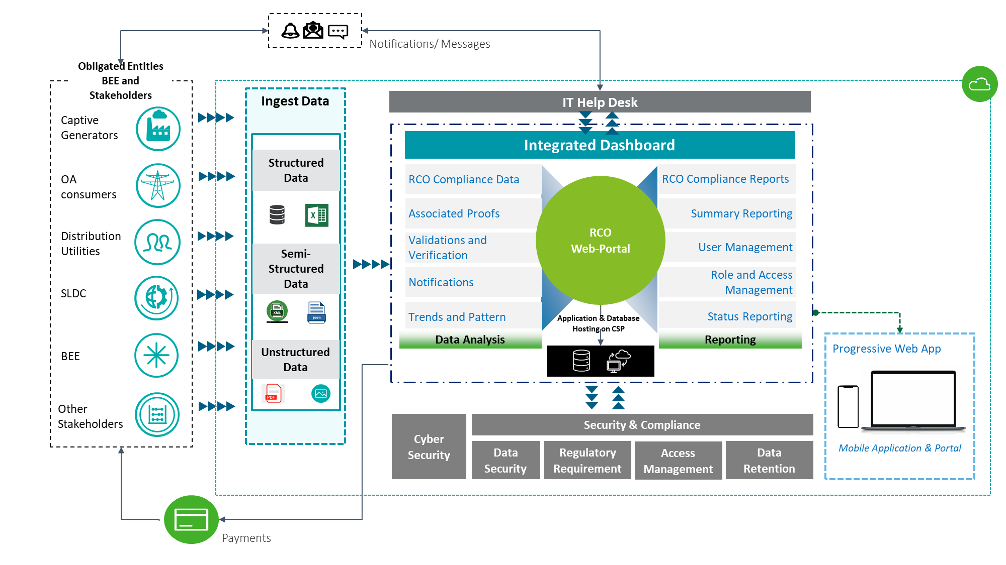
Our Proposed Solution
Our proposed solution ensures a comprehensive, user-friendly web portal that combines robust data management with modern development frameworks, delivering a seamless experience for users and stakeholders.

Slide 22






Our Proposed Solution
Deloitte’s Indicative Architecture for the Proposed Solution
CSP
External Data Source
Data
Application Layer
API/ Web Services
Captive Genco
OA consumers
User Interface
Presentation Layer
Un-structure Data
RCO Monitoring
Payment Module
Discoms
SLDC
Status Update
Associated Proofs
STU
Semi- Structured Data
Data Analysis
Internal Data Source
BEE
Legacy System
Structured Data
Database Layer
3rd Party Integration
Historical Data
SMS/WhatsApp
Data Flow

Slide 23
Indicative Wireframes

Slide 24
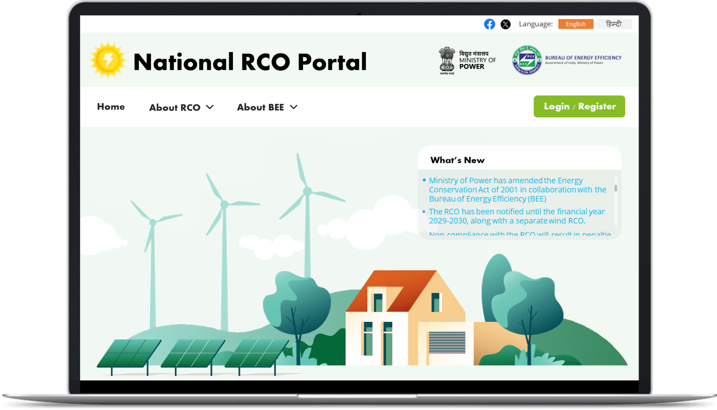
Indicative Wireframe for Portal….1/8

Slide 25
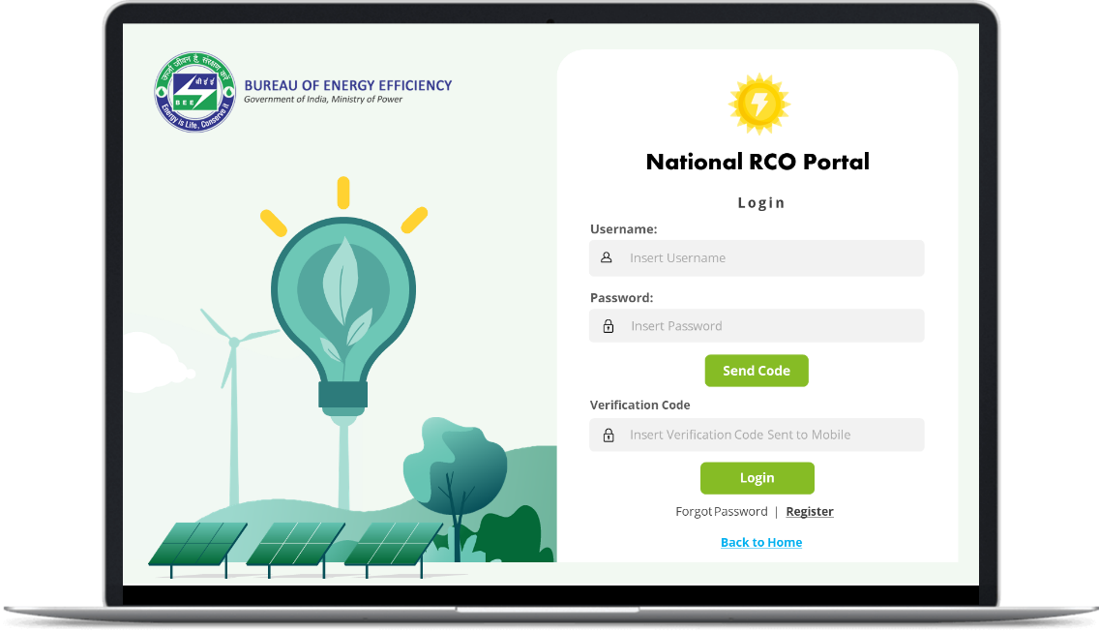

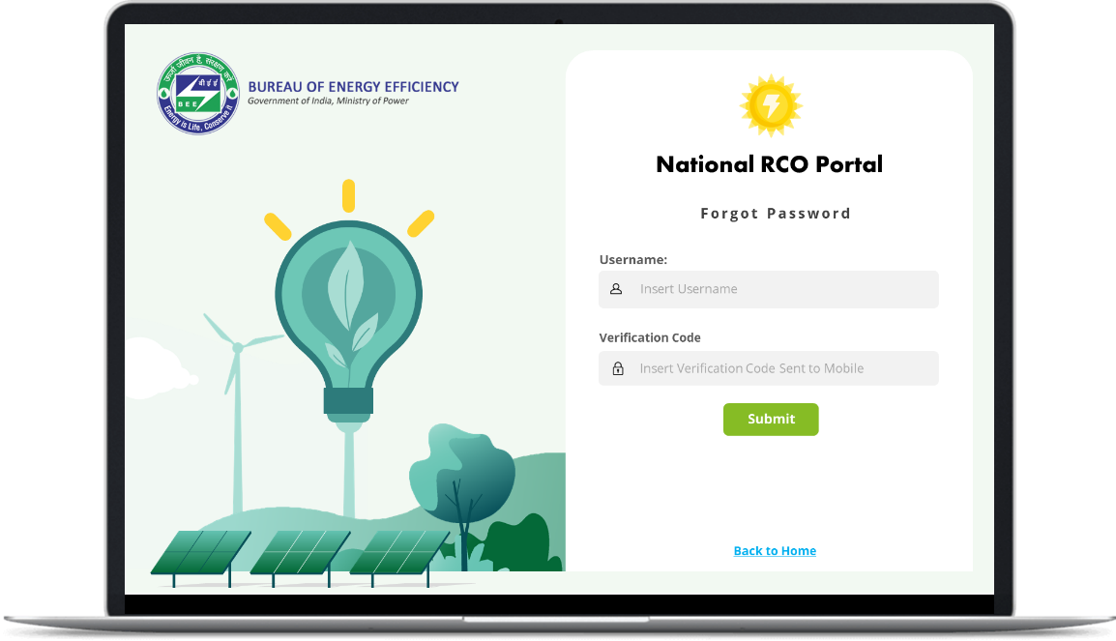

Indicative Wireframe for Portal….2/8
ILLUSTRATIVE

Slide 26
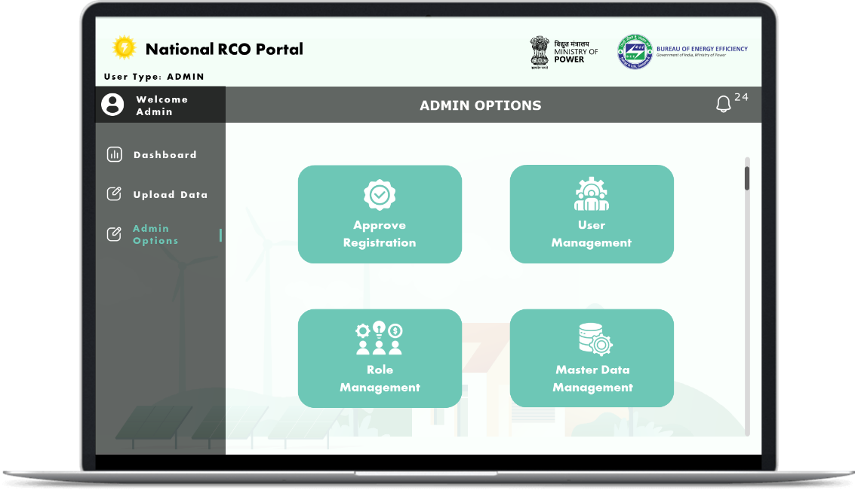
Indicative Wireframe for Portal….8/8
ILLUSTRATIVE

Slide 27
Team Structure

Slide 28


Our Engagement Team
Sombuddha Hazra Chaudhury Project Manager & Power Domain Expert
Anish Mandal
Engagement Leader
Aritro Roy
Solution Architect
Tarun Sahu
QA Engineer
Priyanta Dutta
Software Development Engineer
Aritra Roy
Technical Lead
Hariharan K
Database Administrator
Deepak Upadhyay
Resident Engineer

Slide 29
Project Governance Structure
Roles
Responsibilities
Steering committee
Anujesh Dwivedi
Sombuddha Hazra
Nodal from Client
Steering committee
Make key decisions, sign-off on major deliverables and act on recommendations
Decision-making and escalation, project risks will be reviewed and mitigated jointly by the vendor and BEE’s designated representatives
Project management
Sombuddha Hazra Chaudhury
Project management
Project Manager will ensure objectives are met within timing and scope outlined by the Steering Committee
Plans, organizes, and directs for the completion of a project
Manage day-to-day activities and Status update
Subject experts
Deloitte Backend Support
Subject experts
Support Project team on need basis
Trouble shooting and Problem resolution
Validate architecture/code
Training and Mentoring
Project team
Imran Joya
Aritra Roy
Hariharan K
Tarun Sahu
Priyanta Dutta
Deepak Upadhyay
Project team
Team responsible for deliverables
Solution Architect – Imran, Tech. Lead- Aritra Roy
DBA Administrator – Hariharan K
QA Engg. – Tarun Sahu, Software Developer- Priyanta Dutta
Resident Engineer- Deepak Upadhyay

Slide 30
Deloitte refers to one or more of Deloitte Touche Tohmatsu Limited, a UK private company limited by guarantee (“DTTL”), its network of member firms, and their related entities. DTTL and each of its member firms are legally separate and independent entities. DTTL (also referred to as “Deloitte Global”) does not provide services to clients. Please see www.deloitte.com/about for a more detailed description of DTTL and its member firms.
Deloitte Asia Pacific Limited is a company limited by guarantee and a member firm of DTTL. Members of Deloitte Asia Pacific Limited and their related entities, each of which is a separate and independent legal entity, provide services from more than 100 cities across the region, including Auckland, Bangkok, Beijing, Bengaluru, Hanoi, Hong Kong, Jakarta, Kuala Lumpur, Manila, Melbourne, Mumbai, New Delhi, Osaka, Seoul, Shanghai, Singapore, Sydney, Taipei and Tokyo.
This material has been prepared by Deloitte Touche Tohmatsu India LLP (“DTTILLP”), a member of Deloitte Touche Tohmatsu Limited, on a specific request from you and contains proprietary and confidential information. This material may contain information and/or contents sourced from publicly available information and/or other third-party sources. Further, some of the information and/or contents provided in this material may have been generated by an artificial intelligence language model. While we strive for accuracy and quality, please note that the information and/or the contents provided are on as-is basis without any representations, warranties, undertakings or guarantees of accuracy or completeness and the same may not be entirely error-free or up-to-date. DTTILLP does not independently verify any such sources and is not responsible for any loss whatsoever caused due to reliance placed on information sourced from such sources. The information and/ or contents provided in this material is intended solely for you. Any disclosure, copying or further distribution of this material and/or its contents is strictly prohibited.
Nothing in this material creates any contractual relationship between DTTILLP and you. Any mutually binding legal obligations or rights may only be created between you and DTTILLP upon execution of a legally binding contract. By using this material and any information contained in it, the user accepts this entire notice and terms of use.
©2025 Deloitte Touche Tohmatsu India LLP. Member of Deloitte Touche Tohmatsu Limited

Slide 31
Project Assumptions
Scope Clarity
Significant deviations from the agreed scope may require contract amendments, budget revisions, or timeline adjustments.
Technology Constraints
The solution will be developed using open-source or licensed technologies, as specified in the RFP. Any additional licenses beyond the original scope are addressed through a formal change request.
Timely Provision of Resources
Delays in resource availability (e.g., test users, test data, environment access) may affect milestone achievements.
Regulatory and Policy Compliance
BEE has or will obtain all necessary regulatory clearances for data usage, storage, and transfer, especially when integrating external systems.
Should new regulations or guidelines emerge during the project, BEE and vendor will collaborate on potential scope or design modifications.
Project Governance Structure
A formal governance model (steering committee, change control board) is in place, with defined roles and responsibilities for decision-making and escalation.
Escalations or project risks will be reviewed and mitigated jointly by the vendor and BEE’s designated representatives.
Draft RCO Rules Flexibility
Given that the draft RCO rules are under development by BEE and may change, it is assumed that any significant alterations will be handled via the established change management process. The vendor will adjust designs or functionalities accordingly, with potential impacts on timeline and cost to be evaluated in collaboration with BEE.

Slide 32
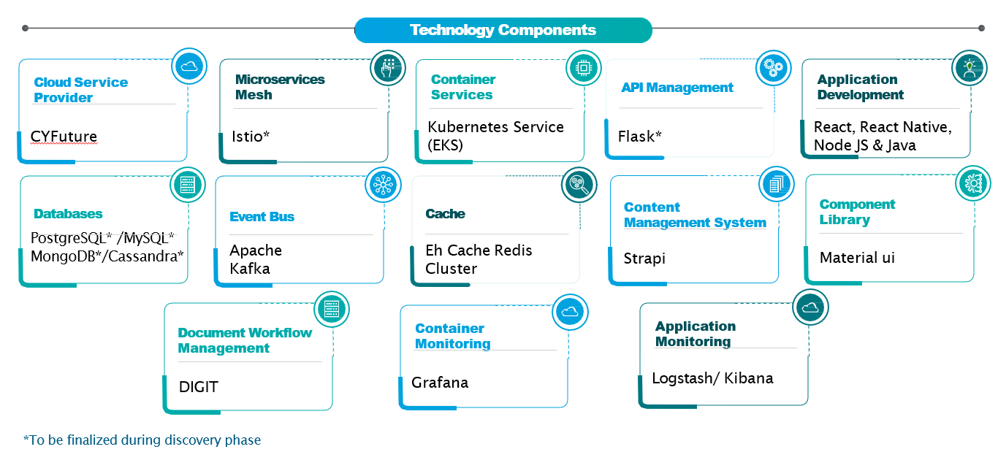

Our Proposed Solution
Our proposed solution ensures a comprehensive, user-friendly web portal that combines robust data management with modern development frameworks, delivering a seamless experience for users and stakeholders.

Slide 33


ER&I Sector Service Offerings
Deloitte India has worked across ER&I sector value chain in India on a range of assignments
Service offering
Clientele
 | Policy and Regulatory Support | ARR and Tariff filings/ reviews Policies & Regulatory Studies Utility Performance Improvement & Review Training & Capacity Building in Electricity Regulations | World Bank, PFC, USAID, MOP, MSPGCL, JBVNL, CERC, FoR, MERC, HPERC, AERC, BERC, PSPCL, JVVNL, MSPGCL, HPGCL, EDP, CED, BSPCL, NBPDCL, SBPDCL, MSPDCL, TSECL, Indiabulls, Sterlite, Lanco, TPC, Renuka Sugar, Bhaskar Shrachi Alloys, Indian Tea Association, Pioneer Gas etc.
 | Web-Portal/ Application Development | Portal/ Application development Analytical Dashboard/ Power BI reporting IMS Software development | RECPDCL, BPCL, JBVNL, CEA, Durgapur Projects Limited, GRIDCO, MDoNER, BIS, Ministry of Defense, GIZ, and others
 | Renewable Energy | Studies, project reviews, regulatory etc. Solar, Wind, SHP and other renewable projects Strategy Formulation & Implementation Support Project Due Diligence | Govt. of Gujarat/ IFC, World Bank, IREDA, JETRO Various private sector players.
 | Utility Support | Financial restructuring & Unbundling Business Process Improvements Digital Transformation Resource adequacy & planning, Energy Transition | USAID Nepal, KPLC, TANESCO, ZESCO, ESCOM, NPCL, YESC and MESC, Myanmar, MSEDCL, MahaGenco, MSETCL, MSLDC, World Bank, Maharashtra, Bihar, Jharkhand, Chhattisgarh, Himachal Pradesh, Assam
Multiple Engagements for applications and software development in past three financial years
National Feeder Monitoring System
Technology Service Provider for Digital Transformation to BPCL
MIS Dashboard development for JBVNL
Implementation of Data Analytics Platform for Bureau of Indian Standards
SAP ERP Solutions for Power Trading and other modules
Himurja Roof Top Solar Application (Single Window Clearance System)

Slide 34
Industry
Our Industry Focus
Telecommunication
Media & Entertainment
Technology
Banking & Capital Markets
Insurance
Investment Management
Real Estate
Health Care
Life Sciences (Pharma)
Life Sciences & Health Care
Technology, Media & Telecommunications
Financial Services
Energy, Resources & Industrials
Consumer
Government & Public Services
Industrial Products & Construction
Power & Utilities
Mining & Metals
Energy & Chemicals
Consumer Products
Retail, Wholesale & Distribution
Automotive
Transportation, Hospitality & Services
Health & Human Services
Defence, Security & Justice
Central Government
Infrastructure, Transport, and Regional Government

